Slide 1
GO Team
Budget Allocation Meeting
January 23, 2025

Slide 2
Agenda
Action Items
Approval of Agenda
Approval of Previous Minutes
Discussion Items
Review Budget Meeting Schedule- Review and update meeting calendar
Budget Allocation Presentation
Information Items
Principal’s Report
  CCRPI Additional items as needed
Announcements
Public Comment Adjournment

Slide 3
Action Items:
Preparing for
Budget Development

Slide 4
Discussion Items

Slide 5
Review & Discuss FY26 GO Team Budget Meeting Schedule
To ensure alignment with the district's budget timeline, we need to review and potentially adjust our current budget meeting schedule. This will ensure timely submission of all required materials.

Slide 6

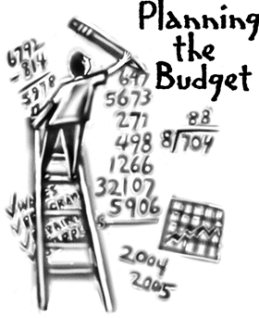
Overview of the FY26 GO Team Budget Process
Step 8* GO Team Final Budget Approval Meeting
Budgets Approved by March 15th
Step 7 Principals HR Staffing Conferences Begin
Feb. 24th – Feb. 27th
Step 6 Cluster Supt. Review February 17th-21st
Step 5* GO Team Feedback Mtg. Early Feb. – Feb 14th
Step 4 Principals Cluster Supt. Discussions
Step 3 GO Team Budget Allocation Meeting
January 15th – January 31st
Step 2 Principals Workshop FY 26 Budget
January 15th
Step 1 Update Strategic Plan & Rank Priorities
GO Teams are encouraged to have ongoing conversations
* GO Teams will need to take ACTION on the budget at these meetings.

Slide 7
Action on GO Team Budget Meeting Calendar
We will need to take ACTION (vote) to change our meeting calendar if we need to change our meetings to meet these deadlines:
Allocation Meeting: now-Jan 31
Feedback Meeting: before February 14
Approval Meeting: after staffing conference and before Friday, March 14.

Slide 8
Budget Development

Slide 9




Norms
This is a meeting of the GO Team. Only members of the team may participate in the discussion. Any members of the public present are here to quietly observe.
We will follow the agenda as noticed to the public and stay on task.
We invite and welcome contributions of every member and listen to each other.
We will respect all ideas and assume good intentions.

Slide 10


GO Team Budget Development Process
YOUR SCHOOL STRATEGIC PLAN…
is your roadmap and your role.
It is your direction, your priorities, your vision,
your present, your future.
Step 1: Data Review
Step 2: Strategic Plan Review
Step 3: Budget Parameters
(Strategic Priorities)
Step 4: Budget Development Process

Slide 11
Budget Allocation Meeting
What
During the first GO Team meeting the principal will provide an overview of the budget and position allocations, request(s) for turnaround and/or signature program funds and review changes to the Gifted Services delivery model (as needed)
Why
This meeting provides an opportunity for the principal and GO Team to ensure alignment on the school’s key strategic priorities, gain a deeper understanding of the budget and position allocations, discuss the proposed requests for signature program funds and provide input to drive the development of the draft budget.
When
January 16 – January 31

Slide 12
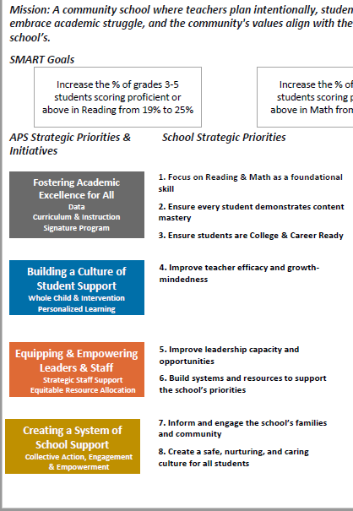
FY26 Budget Development Process
Principal’s Role
Design the budget and propose operational changes that can raise student achievement
Formulate strategies, implement and manage them at the school level
Focus on the day-to-day operations
Serve as the expert on the school
Hire quality instructional and support personnel
Collaborate with the GO Team on the use of school-level flexibility for position allocations, turnaround initiatives, and Signature Programs (NEW PROCESS FOR FY26)
The GO Team’s Role
Focus on the big picture (positions and resources, not people)
Ensure that the budget is aligned to the school’s mission and vision and that resources are allocated to support key strategic priorities
Collaborate with the Principal on the use of school-level flexibility for position allocations, turnaround initiatives, and Signature Programs (NEW PROCESS FOR FY26)

Slide 13
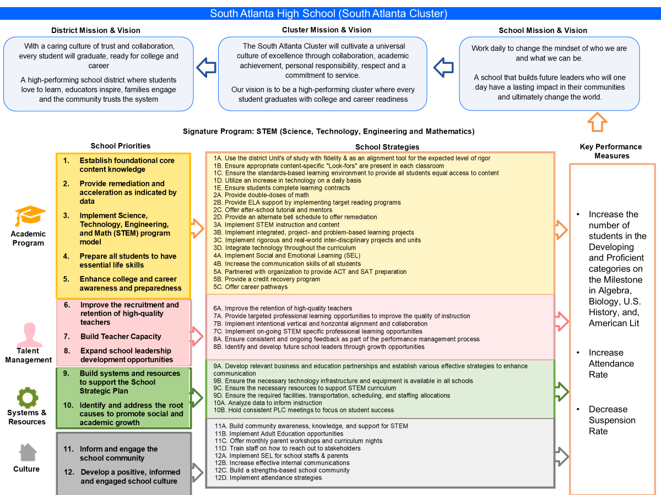
South Atlanta HS Strategic Plan

Slide 14

South Atlanta High School
Strategic Plan
Priority Ranking
Insert the school’s priorities from High to Low
Higher
Academic Program
Talent Management
Culture
Lower

Slide 15
FY 26 Budget Parameters
FY26 Ranked School Priorities | Rationale
Academic Program | Prepare all students to have essential life skills
Talent Management | Build Teacher Capacity
Culture | Develop a positive, informed and engaged school culture.

Slide 16
Discussion of Budget Allocation

Slide 17




Executive Summary
This budget represents an investment plan for our school’s students, employees and the community as a whole.
The budget recommendations are tied directly to the school’s strategic vision and direction.
The proposed budget for the general operations of the school are reflected at $14,657,269
This investment plan for FY26 accommodates a student population that is projected to be 959 students, which is a increase/decrease of 60 students from FY25.

Slide 18
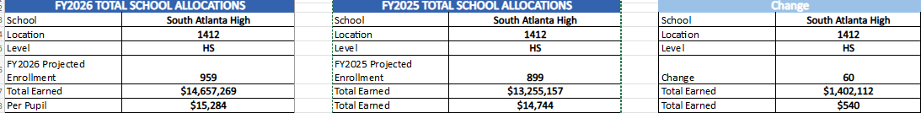
School Allocation Tab Overview
The Allocation Tab has 3 tables that show the allocations for FY26, FY25, and the Change in each area. This helps you understand how our school earned funds and positions for FY26 in comparison to FY25, and how changes in each line impact our overall school budget.

Slide 19
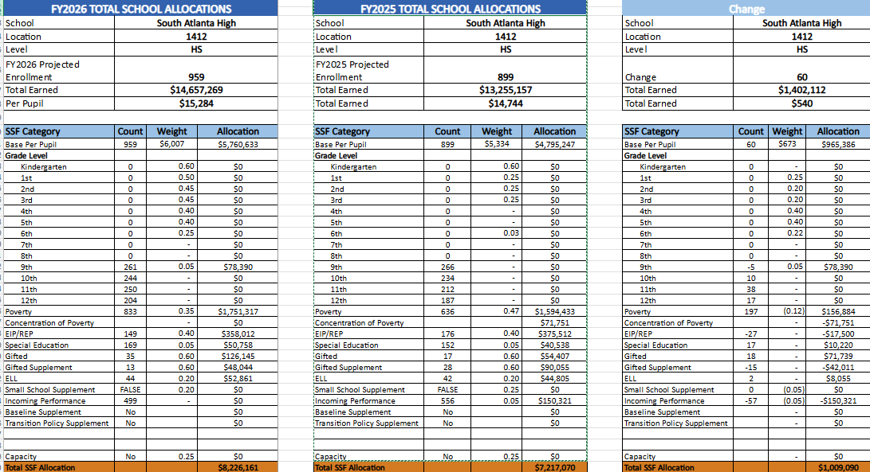
South Atlanta HS SSF Allocations

Slide 20
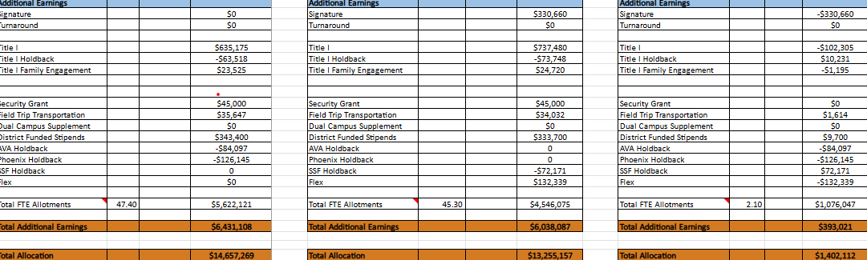
South Atlanta HS Additional Earnings

Slide 21
Summary Tab Overview
Position Title | Earned | Funded | Staffed | Dif | Comments
Teachers
Middle School Core |  | 49.50 | - | (49.50)
Middle Electives |  | 19.00 | - | (19.00)
Teacher Math 6-8 |  |  | 11.00 | 11.00
Teacher Science 6-8 |  |  | 10.00 | 10.00
Teacher Social Studies 6-8 |  |  | 10.00 | 10.00
Teacher ELA 6-8 |  |  | 9.00 | 9.00
Teacher Art 6-8 |  |  | 2.00 | 2.00
Teacher Band 6-8 |  |  | 1.00 | 1.00
Teacher Music 6-8 |  |  | 2.00 | 2.00
Teacher Orchestra 6-8 |  |  | 1.00 | 1.00
Teacher Physical Ed 6-8 |  |  | 7.00 | 7.00
Teacher Performing Arts 6-8 |  |  | 2.00 | 2.00
Teacher World Language 6-8 |  |  | 12.00 | 12.00
Teacher Gifted |  | 13.00 | 11.00 | (2.00)
Teacher Social Emotional Learning |  |  | - | -
EIP TEACHERS |  | 3.50 | 5.00 | 1.50
Teacher REP 6-12 |  |  | 5.00 | 5.00
The Summary Tab provides a summary of the staff in our school. The columns show how many positions are:
Earned – positions allocated by district departments. There is no school-level flexibility with these positions.
Funded – District’s recommended staffing for positions where there is school-level flexibility with staffing the position.
Staffed – This shows how the position is currently staffed at the school.
Difference—This shows the difference between the recommendation in the Funded column and the Staffed Column.
Comments: The principal must provide comments if there is a difference in what is Funded and Staffed. Principals and GO Teams will discuss the rationale provided for the Comments section.
Example

Slide 22
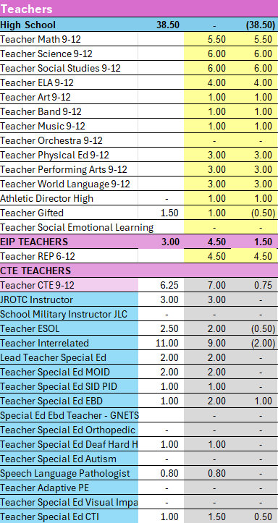

Slide 23
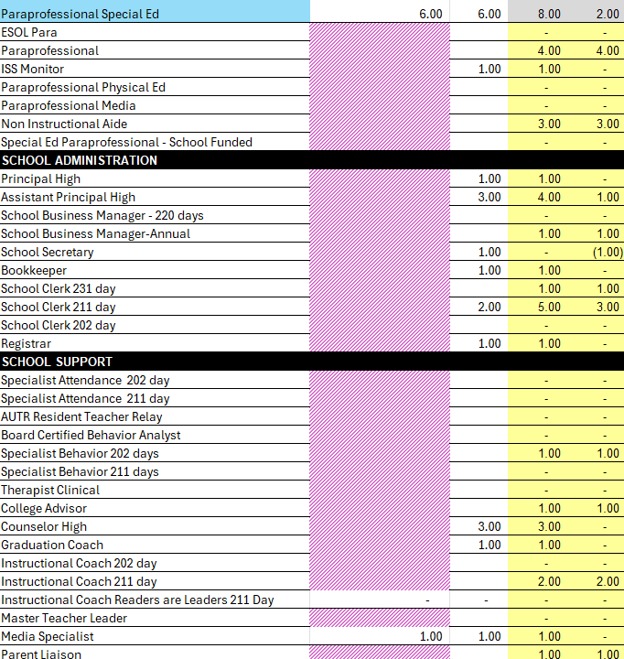

Slide 24
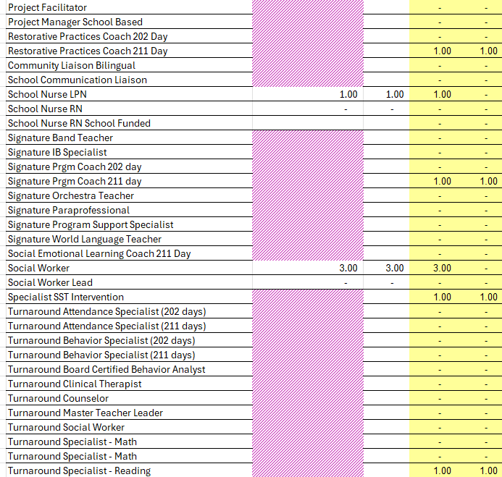

Slide 25
Non-Staffing Tab Overview
Description | Rec. | Allocation | Diff | Notes
Reserve | $ 291,149 | $ 291,149 | $ -
Teacher Stipends |  |  | $ -
Secretary Overtime |  |  | $ -
Contracted Services for Instruction |  |  | $ -
Contracted Services for Professional Development |  |  | $ -
Web-based Subscriptions and Licenses |  |  | $ -
Signature Program Communication/Shipping Fee |  |  | $ -
Computer Software |  | $ - | $ -
Mileage |  |  | $ -
Student Transportation-APS Buses |  |  | $ -
District Funded Field Trips | $ 60,886 | $ 60,886 | $ -
Teaching/Other Supplies | $ 81,900 |  | $ (81,900)
Signature Program Supplies |  |  | $ -
Computer Equipment |  |  | $ -
Media Supplies | $ 13,104 |  | $ (13,104)
The Non-Staffing Tab shows how funds are allocated for non-staff items in the school. There is school-level flexibility for most of these items. The tab has columns for:
Recommended—District’s recommended amount to spend on the line item.
Allocation – This shows how much money has been allocated towards the line item.
Difference—This shows the difference between the recommended amount and the allocation.
Notes: The principal must provide comments if there is a difference in what is Recommended and what is Allocated. Principals and GO Teams will discuss the rationale for the notes section.
Example

Slide 26
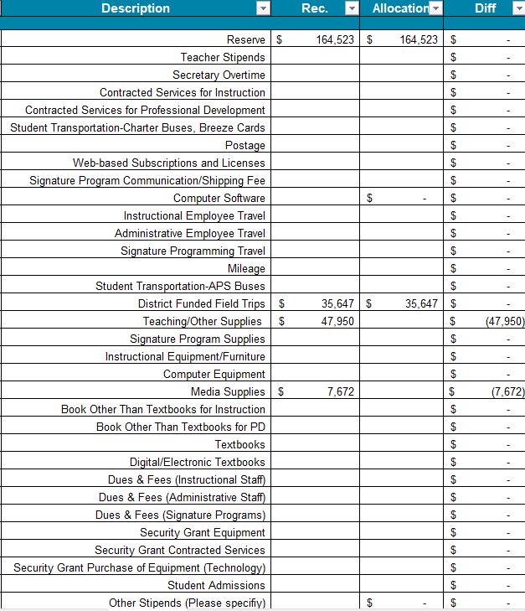

Slide 27


Signature and Turnaround Fund Process Overview
Overview
Process
* The district is piloting a zero-based budgeting (ZBB) process for Signature and Turnaround Program Funds this year.
* Zero-based budgeting (ZBB) is a budgeting process that allocates funding based on program efficiency and necessity rather than budget history. As opposed to traditional budgeting, no item is automatically included in the next budget.
* As such the initial allocation for these programs at all schools will be $0.
* Principals will develop proposed requests for the personnel and non-personnel they need to support the Signature and/or Turnaround Programs at their schools.
* Principals will share and discuss their proposals and rationale for the proposals with their school GO Team for feedback.
* After discussing with their GO Team, principals will submit their request for review by January 31st. Funding for these programs will be provided the week of February 3rd.

Slide 28
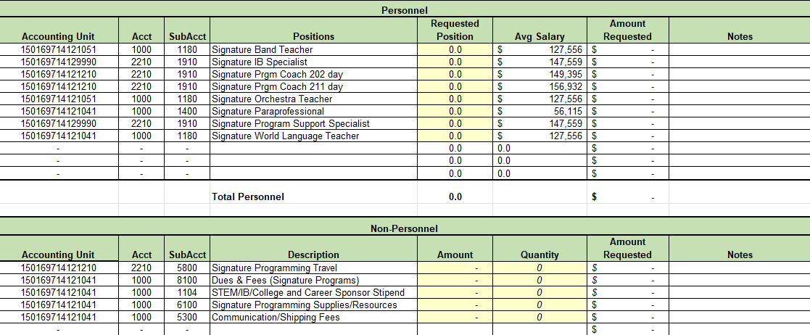
Proposed FY26 Signature Program Fund Request

Slide 29
Proposed Rationale for
FY26 Signature Program Fund Requests
FY26 Signature Program Fund Request | Rationale

Slide 30
What’s Next?
February
  GO Team Feedback Meeting(s) before February 14th
    ACTION (i.e.- GO Team votes) on draft budget before February 14th
  Cluster Superintendent Review (February 17-21)
  HR Staffing Conferences (February 24– February 27)
March
  Final GO Team Approval Meeting (AFTER your school’s Staffing Conference and BEFORE Friday, March 14th)
    ACTION (i.e.- GO Team votes) on final budget recommendation before March 14

Slide 31

Questions?
Thank you for your time and attention.

Slide 32
Information Items

Slide 33
Principal’s Report
CCRPI Results

Slide 34
Thank you

